Slide 1
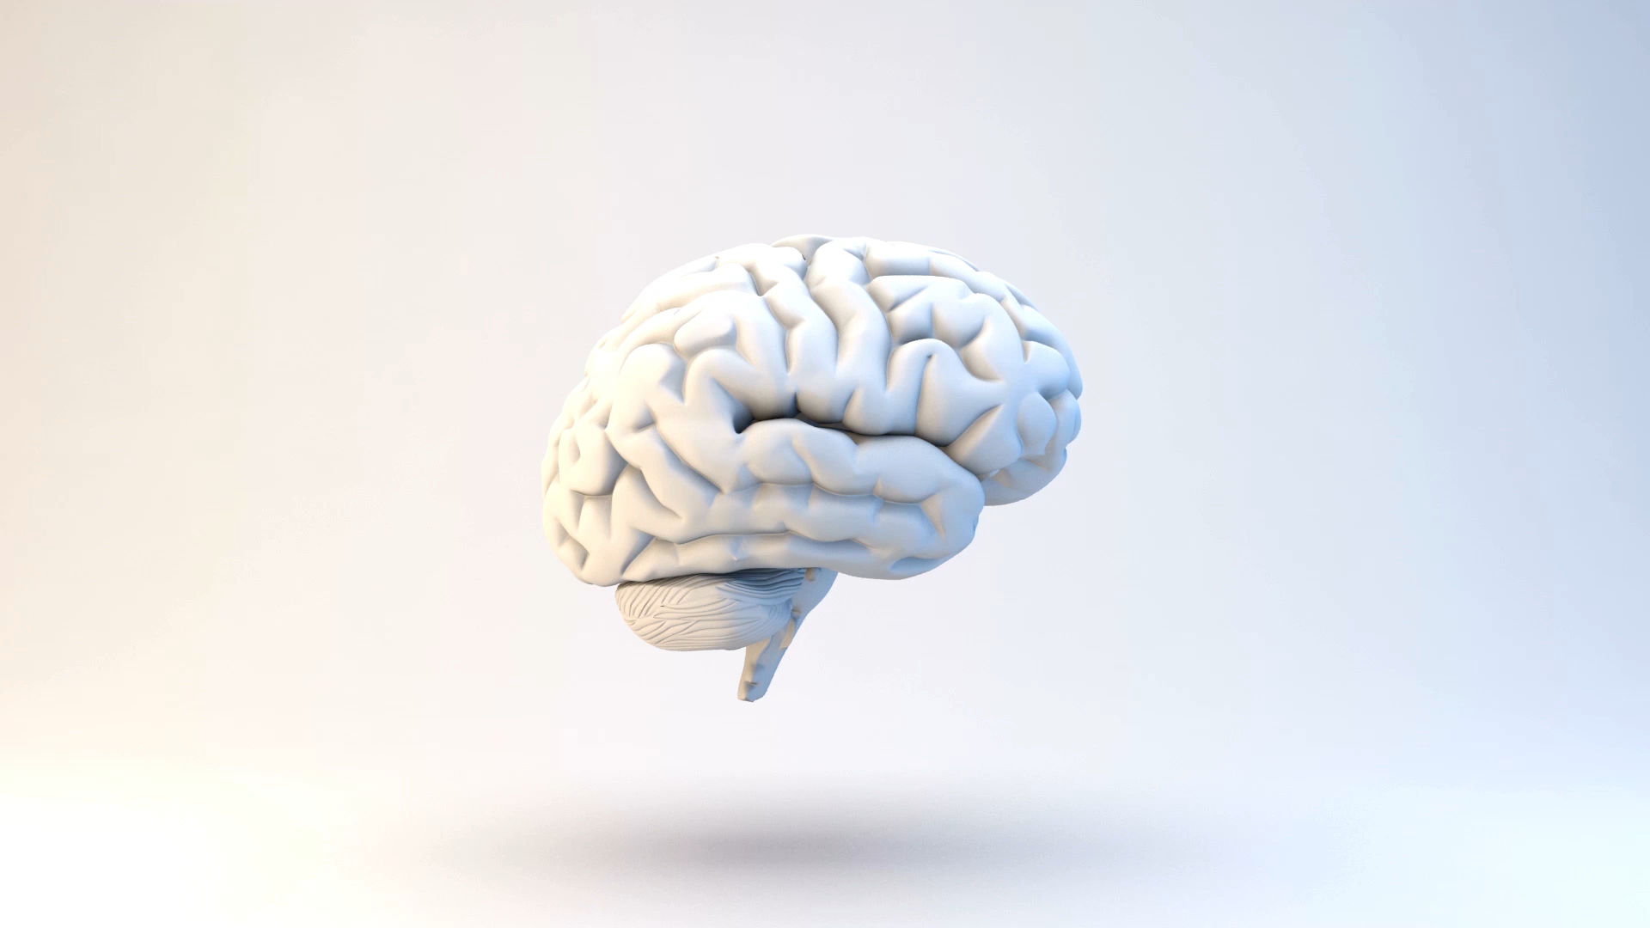
Artificial Intelligence and Computer Vision
By Patrick Nohra

Slide 2

contents
Introduction to Artificial Intelligence and Machine Learning
Types of Learning
Neural Networks and Convolutional-NN
Programming Side of Deep Learning
What is Computer Vision
Demos

Slide 3
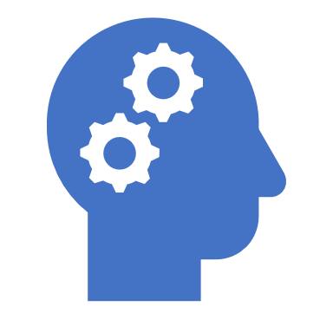
What is Artificial Intelligence
Building smart machines capable of performing tasks that typically require human intelligence.

Slide 4

How do computers learn?
A machine "learns" by searching for patterns in huge amounts of data, and when it finds one, it modifies the program to reflect the "truth" of what it discovered.
The more data the computer is exposed to, the "smarter" it becomes.
When it notices enough patterns, it starts making predictions.
This field is called Machine Learning

Slide 5
Types of learning
Supervised Learning
Unsupervised Learning
Reinforcement Learning

Slide 6
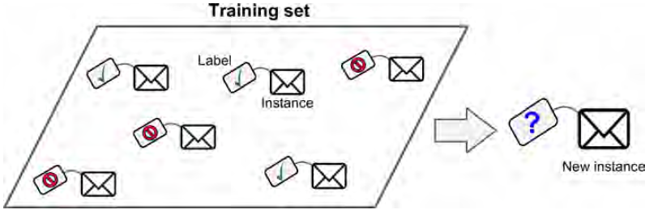
Supervised Learning
In supervised learning, the training data you feed to the algorithm includes the desired solutions, called labels
Supervised learning algorithms: Linear Regression,
k-Nearest Neighbors, Neural Networks

Slide 7
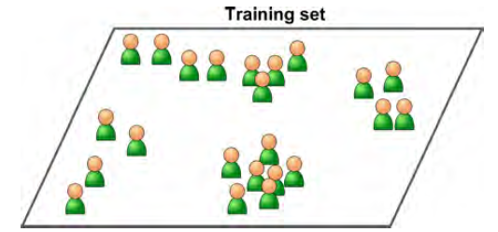
Unsupervised Learning
In unsupervised learning the training data is unlabeled the system tries to learn without a teacher.
Supervised learning algorithms: Clustering; Neural Networks

Slide 8
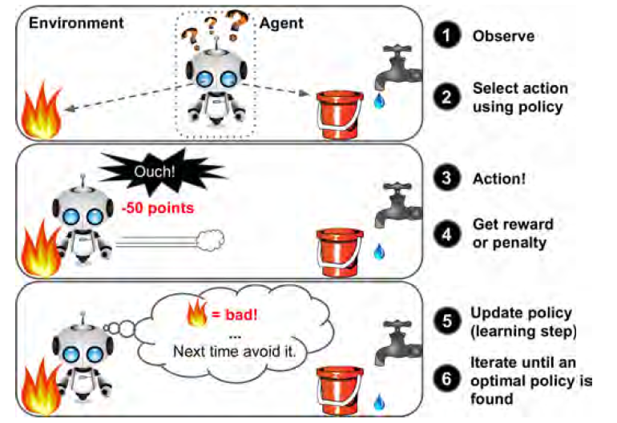
reinforcement Learning

Slide 9

What are Neural Networks
A deep neural network is a layered representation of data. The term "deep" refers to the presence of multiple layers.
It attempts to represent our data in different ways and in different dimensions by applying specific operations to transform our data at each layer.
By performing these transformations, the model can better understand our data and therefore provide a better prediction.

Slide 10
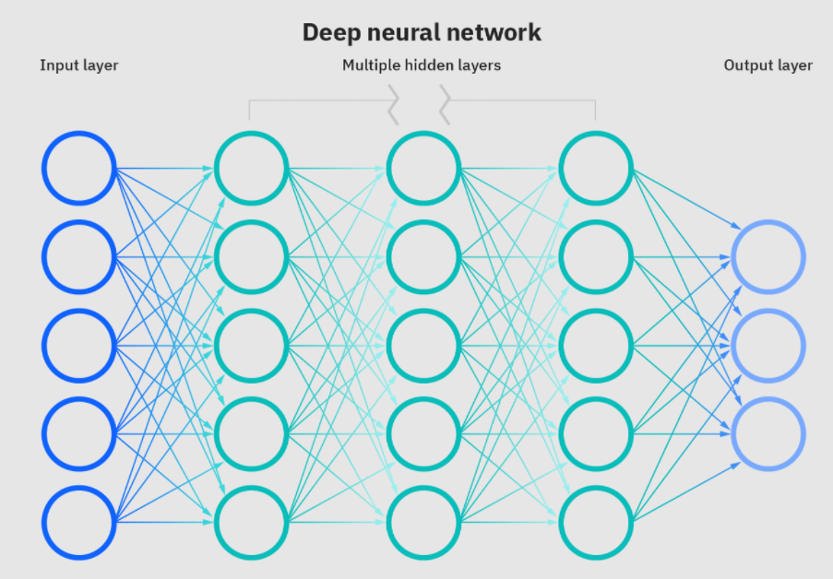
How it Works

Slide 11
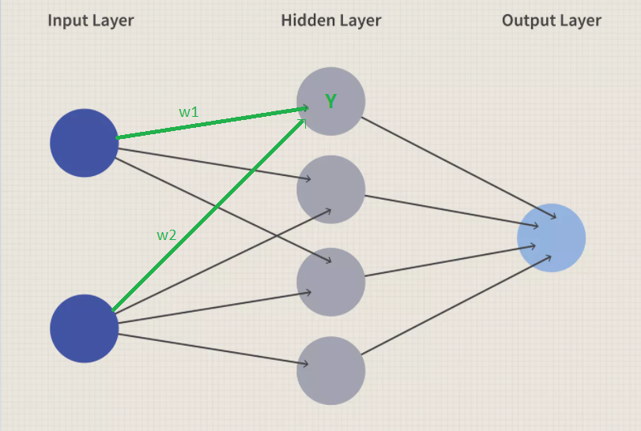
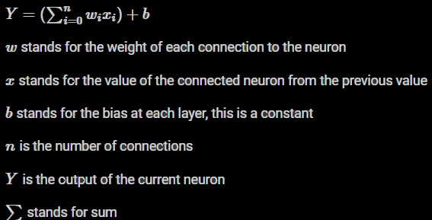
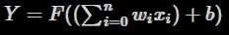

Slide 12
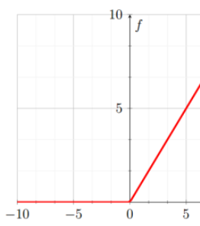
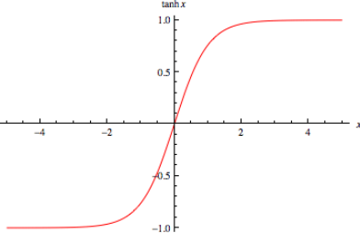
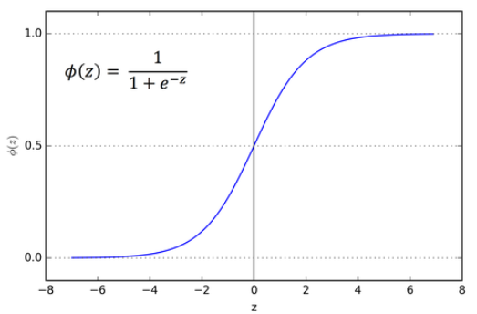
Activation Functions
By transforming our data to a higher dimension, we can typically make better, more complex predictions.

Slide 14
Backpropagation, loss function and optimizer
Backpropagation is the fundamental method used in neural network training. It is what causes our network's weights and biases to shift.
This function oversees determining how well the network performed. We provide it the actual and predicted outputs, and it returns some number reflecting the network's cost/loss. (mean squared average – mean absolute error – hinge loss)
The optimizer is the function that implements the backpropagation algorithm. Gradient Descent is an example of an optimizer. Gradient descent and backpropagation are closely related. Backpropagation is the algorithm used to get the optimal parameters for our network, while gradient decent is the process of calculating the gradient to reduce the loss function.

Slide 15
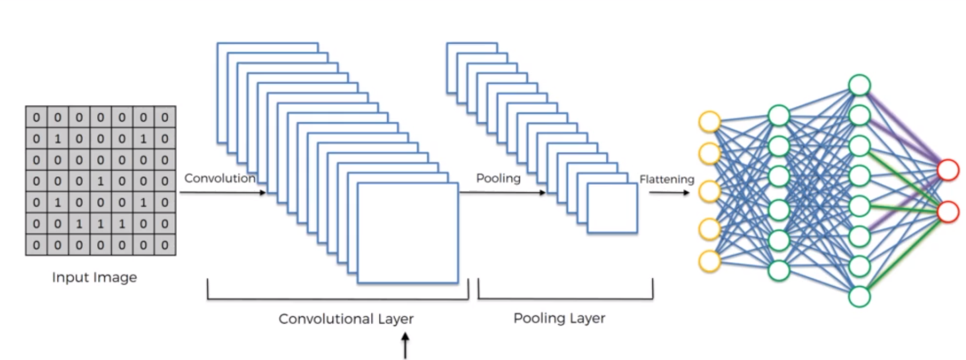
Convolutional neural networks

Slide 16
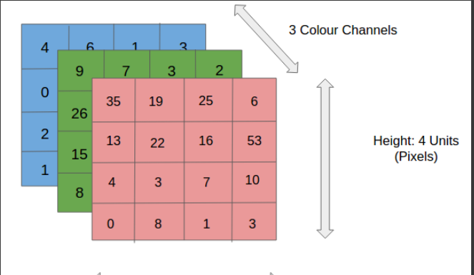
Input image

Slide 17
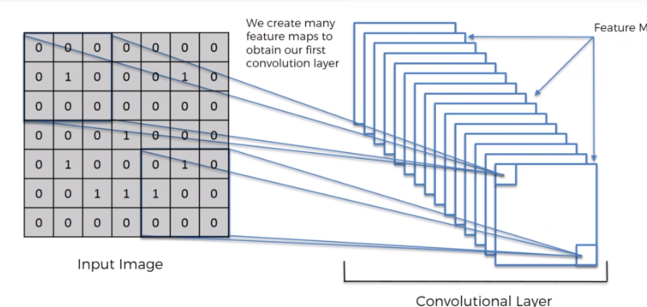
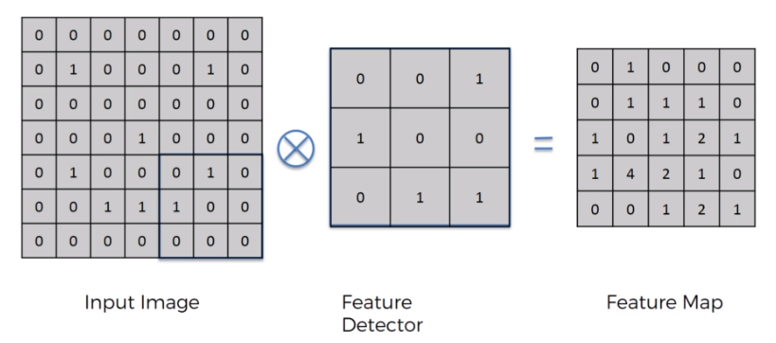
Convolutional layers
Each convolutional neural network consists of one or more convolutional layers. Their objective is to discover patterns in pictures that may be used to classify the image or sections of it.

Slide 18
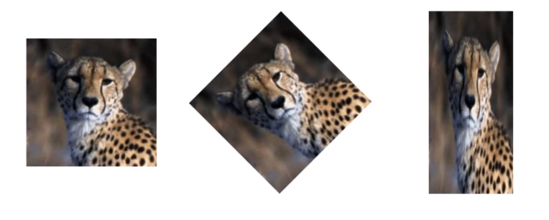
pooling
The idea behind a pooling layer is to down-sample our feature maps and reduce their dimensions. They work in a similar way to convolutional layers where they extract windows from the feature map and return a response map of the max, min or average values of each channel.

Slide 19
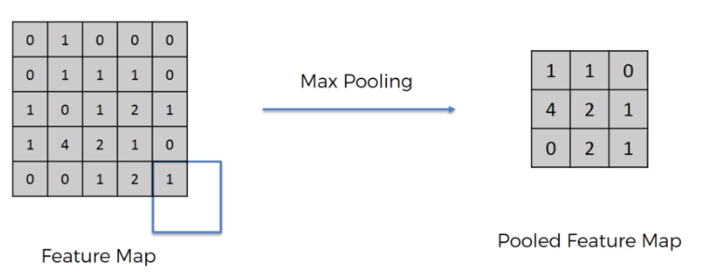

Slide 20
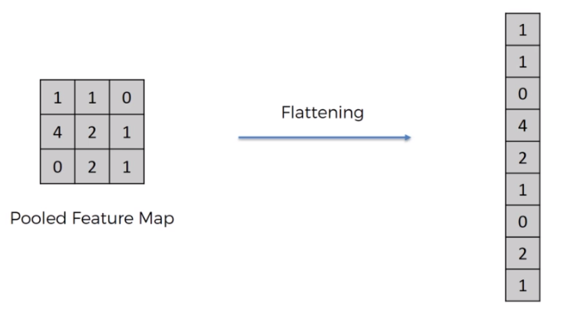
flattening

Slide 21
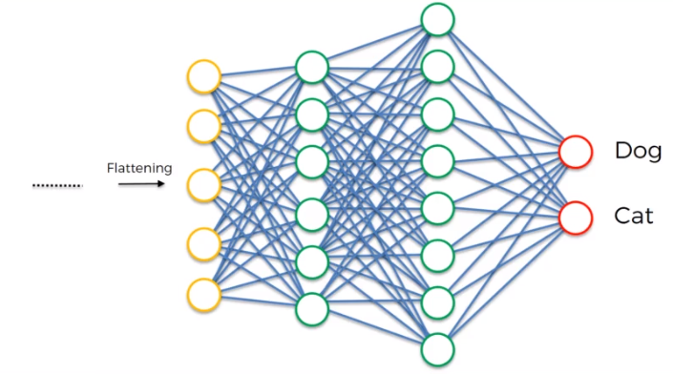
Full connection

Slide 22
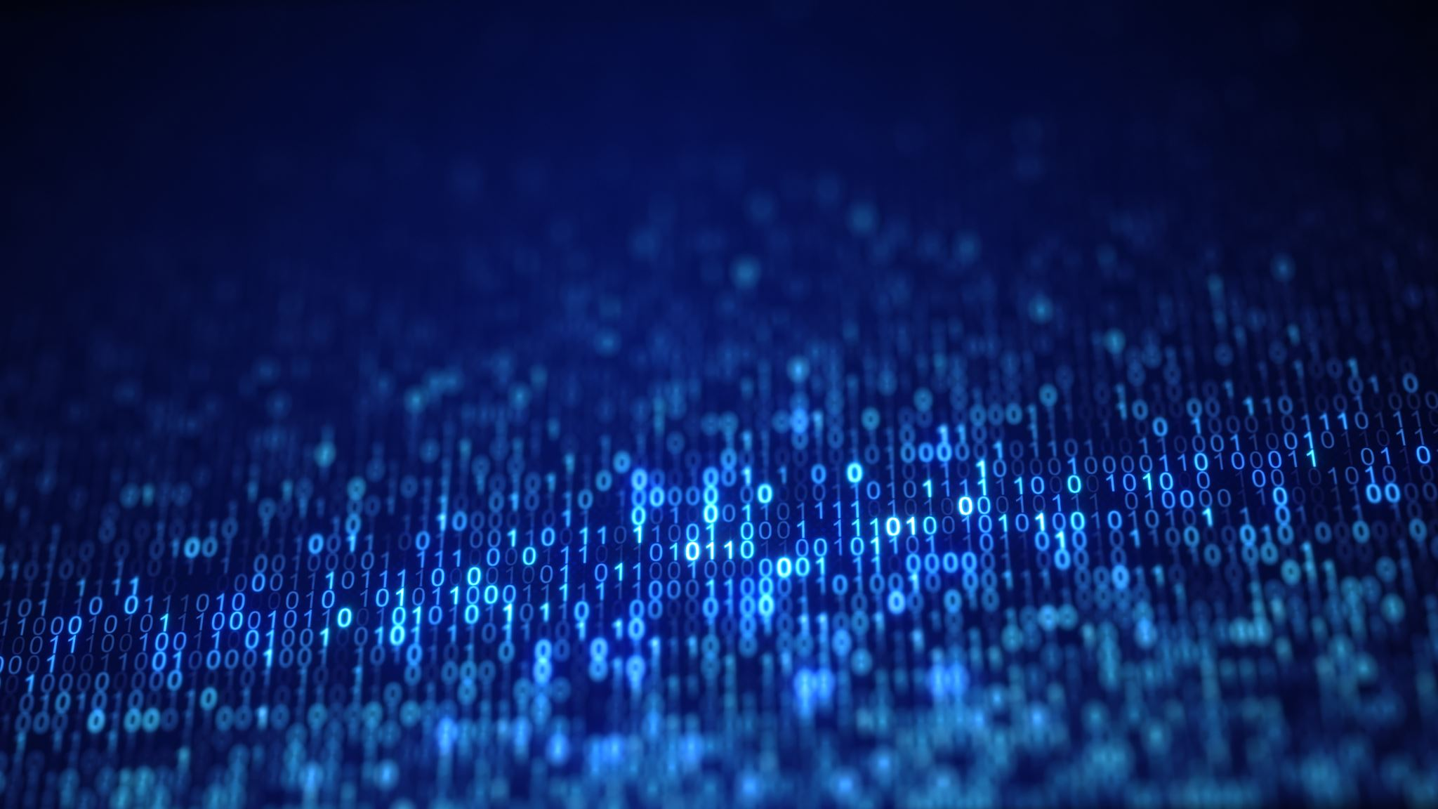
Programming

Slide 23

Programming Language: python
Python seems to be winning the battle as the preferred language of Machine Learning. The availability of libraries and open-source tools make it ideal choice for developing ML models.

Slide 24
Python libraries for machine learning
When TensorFlow was open-sourced in November 2015, there were already many popular open-source libraries for Deep Learning and to be fair most of TensorFlow’s features already existed in one library or another. Nevertheless,
TensorFlow’s clean design, scalability, flexibility, and great documentation quickly boosted it to the top of the list. In short, TensorFlow was designed to be flexible, scalable, and production-ready, and existing frameworks arguably hit only two out of the three of these.
TensorFlow
Handling deep neural networks
Natural Language Processing
Partial Differential Equation
Abstraction capabilities
Image, Text, and Speech recognition
Effortless collaboration of ideas and code
Core Task: Build Deep Learning models

Slide 25
Python libraries for machine learning
Pytorch
Considered among the top contenders in the race of being the best Machine Learning and Deep Learning framework, PyTorch faces tough competition from TensorFlow.
Pros: very customizable, widely used in deep learning research
Cons: fewer NLP abstractions, not optimized for speed
Core task: Developing and training deep learning models

Slide 26
Python libraries for machine learning
Keras is one of the most popular and open-source neural network libraries for Python. Initially designed by a Google engineer, Keras was soon supported in TensorFlow’s core library making it accessible on top of TensorFlow.
Keras
Neural layers
Activation and cost functions
Objectives
Batch normalization
Dropout
Pooling

Slide 27

What is Computer Vision
Notes:
Computer vision is a field of artificial intelligence that trains computers to interpret and understand the visual world by duplicating the ability of human vision through digital perceiving and understanding an image (give examples using the picture in the slides).

Slide 28
Image processing using opencv
Resize
Blur
Change color space

Slide 29
Image processing using OpenCV
Edges
Contours
Mask

Slide 30
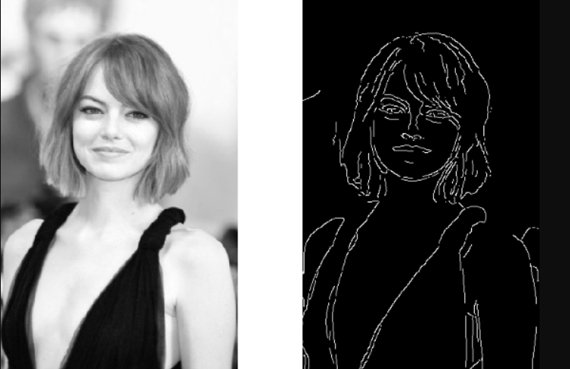
Finding edges

Slide 31
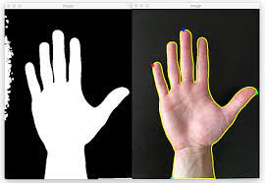
Drawing contours

Slide 32
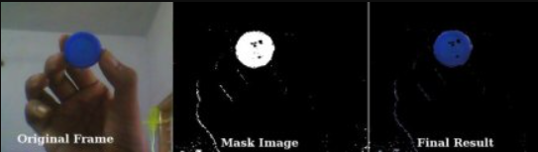
Masking

Slide 33

demonstrations

Slide 34
Thank you

Slide 35
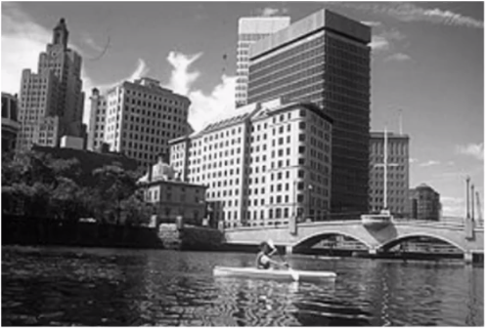
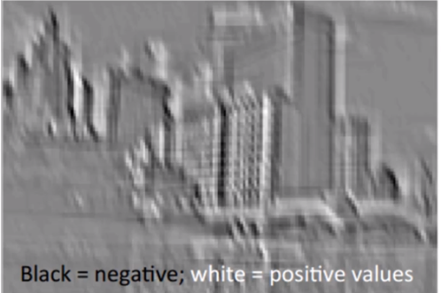
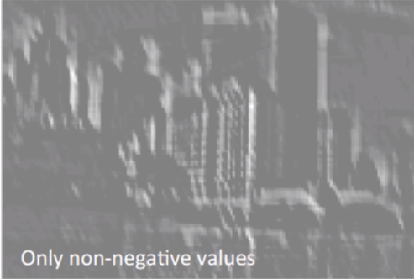
rectifier
ORIGINAL IMAGE
AFTER APPLYING FEATURE DETECTOR
AFTER ReLU LAYER
To increase nonlinearity in the network since images by nature have nonlinear elements.

